Slide 1
Motivation and Leadership
Objective:To enable students to analyze and address key issues in motivating and leading a technical workforce
6 hrs

Slide 2
3.1 Motivation
3.1.1 Theories of motivation:
Maslow’s hierarchy
Herzberg’s two factor, Expectancy, Equity
3.1.2 Techniques for motivation

Slide 3
Concept of Motivation
The term motive is derived from the latin word “movere” which means “to move”
Motives have been classified in many ways:
Primary motives (Biological)
Secondary motives (Social)
From organizational perspectives motives are:
Internal motives (ego needs: freedom, prestige, recognition, status etc)
External Motives (Arises from the social and family influences)

Slide 4
Definition of Motivation
Motivation means inducement to act or move from inner impulse or drivers
In an organizational setting, motivation means to make an employee act in a desired manner
Desired manner is related to discipline, efficiency and productivity
To motivate is to induce, persuade, stimulate, even compel an employee to act in a manner so as to achieve

Slide 5
The motivational Process
Motivation is a concern of three factors
What energizes behavior?
What directs or channels behavior?
How this behavior is maintained and sustained?
Motivation is a complex process
Motives can not be seen but can be inferred
Drivers of motives are instantaneous
Same incentives may be perceived differently
Some motives are diminishing (hunger, thirst and sex)
An individual may be unware of his motives
Motivation is situational

Slide 6
Types of motivation
Intrinsic Motivation
Intrinsic motivation is related to skill and creative instinct (outward)
Extrinsic Motivation
This is external to the job or task (outward). Examples are: Praise, recognition, admiration, working conditions, and other facilities

Slide 7
Theories of Motivation
Research questions.
What forces within people, or within their environments, lead to motivation?
This is related to content theories
What processes or mechanisms are involved in motivational behavior?
This is related to process theories

Slide 8
Maslow’s Theory
The best-known theory of motivation is probably Abraham Maslow’s hierarchy of needs theory.
Maslow was a psychologist who proposed that within every person is a hierarchy of five needs
Maslow argued that each level in the needs hierarchy must be substantially satisfied before the next need becomes dominant
An individual moves up the needs hierarchy from one level to the next.

Slide 9
Maslow’s Hierarchy of Needs Theory
Hierarchy of needs theory: Maslow’s theory that human needs—physiological, safety, social, esteem, and self-actualization—form a hierarchy and that each level in the needs hierarchy must be substantially satisfied before the next need becomes dominant
Notes:
The best-known theory of motivation is probably Abraham Maslow’s hierarchy of needs theory. Maslow was a psychologist who proposed that within every person is a hierarchy of five needs.
Maslow argued that each level in the needs hierarchy must be substantially satisfied before the next need becomes dominant. An individual moves up the needs hierarchy from one level to the next.

Slide 10
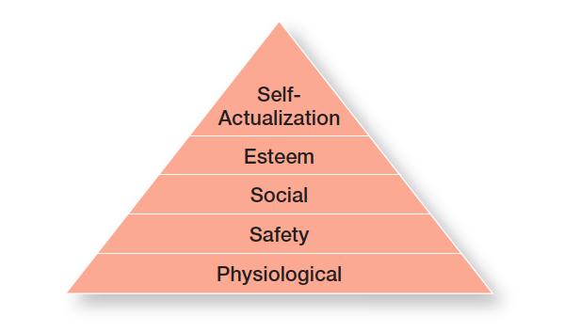
Physiological needs: a person’s needs for food, drink, shelter, sexual satisfaction, and other physical needs
Safety needs: a person’s needs for security and protection from physical and emotional harm
Social needs: a person’s needs for affection, belongingness, acceptance, and friendship
Esteem needs: a person’s needs for internal factors such as self-respect, autonomy, and achievement, and external factors such as status, recognition, and attention
Self-actualization needs: a person’s need to become what he or she is capable of becoming

Slide 11
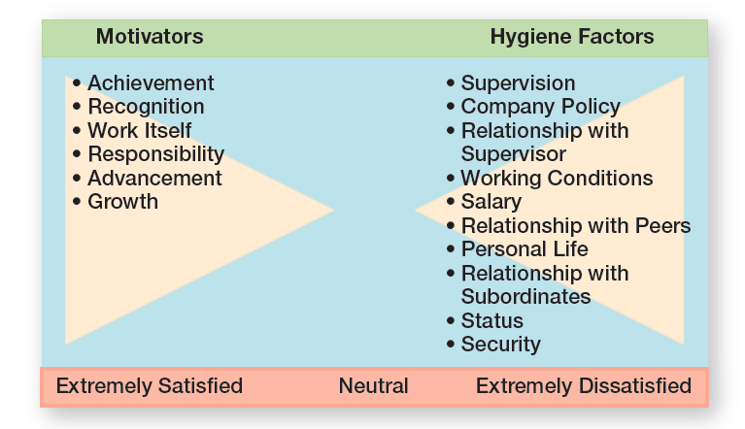
Frederick Herzberg’s two-factor theory
Herzberg wanted to know when people felt exceptionally good (satisfied) or bad (dissatisfied) about their jobs.

Slide 12
Frederick Herzberg’s two-factor theory
He concluded that the replies people gave when they felt good about their jobs were significantly different from the replies they gave when they felt badly
Certain characteristics were consistently related to job satisfaction (factors on the left side of the exhibit), and others to job dissatisfaction (factors on the right side)
The extrinsic factors that create job dissatisfaction were called hygiene factors. When these factors are adequate, people won’t be dissatisfied, but they won’t be satisfied (or motivated) either
To motivate people, Herzberg suggested emphasizing motivators, the intrinsic factors having to do with the job itself.

Slide 13
Herzberg’s Two-Factor Theory
Two-factor theory (motivation-hygiene theory): the motivation theory that intrinsic factors are related to job satisfaction and motivation, whereas extrinsic factors are associated with job dissatisfaction
Hygiene factors: the extrinsic factors that remove job dissatisfaction
Motivators: the intrinsic factors having to do with the job itself
Notes:
Frederick Herzberg’s two-factor theory (also called motivation-hygiene theory) proposes that intrinsic factors are related to job satisfaction, while extrinsic factors are associated with job dissatisfaction.
Herzberg wanted to know when people felt exceptionally good (satisfied) or bad (dissatisfied) about their jobs. (These findings are shown in Exhibit 16-2.) He concluded that the replies people gave when they felt good about their jobs were significantly different from the replies they gave when they felt badly. Certain characteristics were consistently related to job satisfaction (factors on the left side of the exhibit), and others to job dissatisfaction (factors on the right side).
The extrinsic factors that create job dissatisfaction were called hygiene factors. When these factors are adequate, people won’t be dissatisfied, but they won’t be satisfied (or motivated) either. To motivate people, Herzberg suggested emphasizing motivators, the intrinsic factors having to do with the job itself.

Slide 14
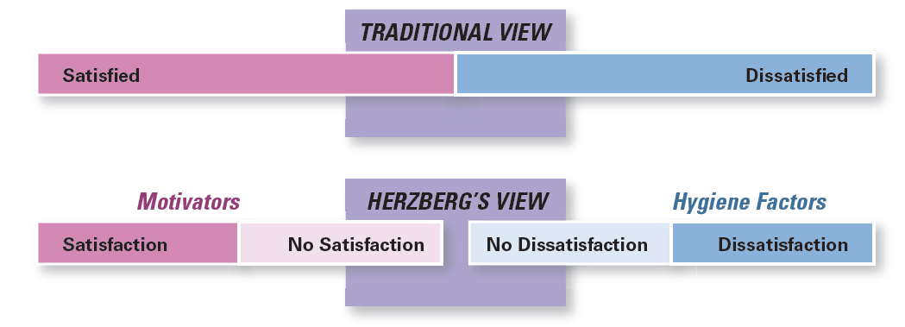
Contrasting Views of Satisfaction and Dissatisfaction
As shown in Figure, Herzberg proposed that a dual continuum existed: The opposite of “satisfaction” is “no satisfaction,” and the opposite of “dissatisfaction” is “no dissatisfaction.”
Notes:
Herzberg believed the data suggested that the opposite of satisfaction was not dissatisfaction, as traditionally had been believed. Removing dissatisfying characteristics from a job would not necessarily make that job more satisfying (or motivating). As shown in Exhibit 14-3, Herzberg proposed that a dual continuum existed: The opposite of “satisfaction” is “no satisfaction,” and the opposite of “dissatisfaction” is “no dissatisfaction.”
Long Description:
The chart shows the two states, “Satisfied” and “Dissatisfied”, for “Traditional View.” The “Herzberg’s View” shows 4 states as follows.
Motivators
Satisfaction
No satisfaction
Hygiene Factors
No dissatisfaction
Dissatisfaction

Slide 15
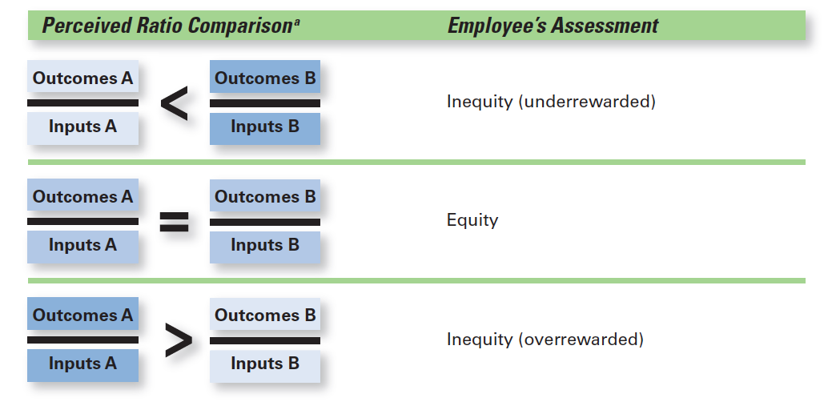
Equity Theory
Developed by J. Stacey Adams, proposes that employees compare what they get from a job (outcomes) in relation to what they put into it (inputs), and then they compare their inputs–outcomes ratio with the ratios of relevant others

Slide 16
Equity Theory
Equity theory: The theory that an employee compares his or her job’s input-outcomes ratio with that of relevant others and then corrects any inequity
If an employee perceives their ratio to be equitable in comparison to those of relevant others, there’s no problem
However, if the ratio is inequitable, they view themself as under rewarded or overrewarded
Notes:
Equity theory, developed by J. Stacey Adams, proposes that employees compare what they get from a job (outcomes) in relation to what they put into it (inputs), and then they compare their inputs–outcomes ratio with the inputs–outcomes ratios of relevant others (Exhibit 16-7). If an employee perceives her ratio to be equitable in comparison to those of relevant others, there’s no problem. However, if the ratio is inequitable, she views herself as underrewarded or overrewarded. When inequities occur, employees attempt to do something about it. The result might be lower or higher productivity, improved or reduced quality of output, increased absenteeism, or voluntary resignation.

Slide 17
Equity Theory
Referents: the persons, systems, or selves against which individuals compare themselves to assess equity
Distributive justice: perceived fairness of the amount and allocation of rewards among individuals
Procedural justice: perceived fairness of the process used to determine the distribution of rewards
Notes:
The referent—the other persons, systems, or selves individuals compare themselves against in order to assess equity—is an important variable in equity theory.
Originally, equity theory focused on distributive justice, the perceived fairness of the amount and allocation of rewards among individuals. More recent research has focused on looking at issues of procedural justice, the perceived fairness of the process used to determine the distribution of rewards.
Research shows that distributive justice has a greater influence on employee satisfaction than procedural justice, while procedural justice tends to affect an employee’s organizational commitment, trust in his or her boss, and intention to quit.

Slide 18
Expectancy Theory
The most comprehensive explanation of how employees are motivated is Victor Vroom’s expectancy theory
Expectancy theory states that an individual tends to act in a certain way based on the expectation that the act will be followed by a given outcome and on the attractiveness of that outcome to the individual
It includes three variables or relationships

Slide 19
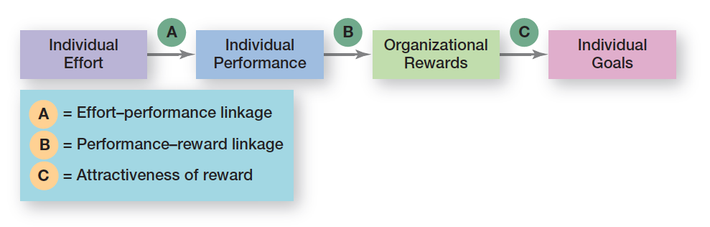
Figure illustrates the three relationships in the expectancy model.

Slide 20
Expectancy Relationships
1. Expectancy or effort–performance linkage is the probability perceived by the individual that exerting a given amount of effort will lead to a certain level of performance.
2. Instrumentality or performance–reward linkage is the degree to which the individual believes that performing at a particular level is instrumental in attaining the desired outcome.
3. Valence or attractiveness of reward is the importance an individual places on the potential outcome or reward that can be achieved on the job. Valence considers both the goals and needs of the individual.

Slide 21
Techniques of Motivation
Manger needs to be sure of the following:
Positive reinforcement
Fair treatment
Understand and address employee’s needs
Incentives for learning, creativity and innovation
Teach and remind procedure consistent with goals
Restructure and reorganize jobs whenever necessary
Have a reward system based on job performance

Slide 22
Reward system to motivate performance
Extrinsic rewards
Intrinsic rewards
Compensation
Incentive system
Employee share ownership
Flexible benefits
Merit awards
Knowledge or skill based pays

Slide 23
Effective Reward Management
Reward must satisfy needs
One must believe that efforts will lead to reward
Rewards must be equitable
Rewards must be linked with performance
Motivation through Employee Participation
Quality of Work Life
Adequate and fair compensation
A safe and healthy environment
Opportunity for developing human capabilities, personal growth and security
Quality of Work Life
Social Environment
Work role with no personal time consumption
Work with personal freedom, rights and dignity

Slide 24
Mechanisms to achieve QWL Quality of Work Life
Quality Circle
Employee’s Share Ownership
Flexible work schedules
Self Managed Work Teams

Slide 25
Technology and Motivation
Constantly advancing technology is impacting how, where, and when we work, influencing motivation in several ways
Technology can increase the pace of work, leading to workers feeling a loss of control
With the effective integration of technology in work, companies could increase motivation by providing opportunities to provide meaningful work
The flexibility offered by remote work could also positively impact worker motivation as they are able to better manage their lives
Notes:
Without intentionality, technology integration into work could negatively impact motivation because psychological needs are not met. For example, technology can increase the pace of work, leading to workers feeling a loss of control. Or remote work that provides less in-person interaction could impact employees’ ability to create meaningful relationships at work.
To address the need for interaction, many workers prefer hybrid work options. In fact, following the COVID-19 pandemic, 52 percent of workers preferred hybrid work, compared to 11 percent who preferred fully remote work and 37 percent who wanted to return to fully on-site work. With intentionality, workers can still build relationships while working remotely.

Slide 26
Managing Cross-Cultural Motivational Challenges
In today’s global business environment, managers can’t assume motivational programs that work in one location will work in others.
Most current motivation theories were developed in the United States by Americans and about Americans.
Notes:
In today’s global business environment, managers can’t automatically assume motivational programs that work in one geographic location are going to work in others. Most current motivation theories were developed in the United States by Americans and about Americans. Maybe the most blatant pro-American characteristic in these theories is the strong emphasis on individualism and achievement. For instance, both goal-setting and expectancy theories emphasize goal accomplishment as well as rational and individual thought.

Slide 27
Motivating Unique Groups of Workers
To maximize motivation among today’s workforce, managers need to think in terms of flexibility
The flexibility that motivates a worker depends on several factors including age and gender
For example;
Millennials value social relationships
Older workers, are likely to enjoy being part of a team
Gen Z workers value opportunities for growth, clear responsibilities, and feedback
Notes:
Employees come into organizations with different needs, personalities, skills, abilities, interests, and aptitudes. They have different expectations of their employers and different views of what they think their employer has a right to expect of them. And they vary widely in what they want from their jobs.

Slide 28
Motivating Professionals
Job challenge
Support
Finding solutions to problems
Perception that their work is important
What motivates professionals? Money and promotions typically are low on their priority list.
Why? They tend to be well paid and enjoy what they do.
In contrast, job challenge tends to be ranked high.
They like to tackle problems and find solutions.
Their chief reward is the work itself.
Professionals also value support.
They want others to think that what they are working is their central life interest, whereas nonprofessionals typically have other interests outside of work that can compensate for needs not met on the job.
Notes:
What motivates professionals? Money and promotions typically are low on their priority list. Why? They tend to be well paid and enjoy what they do. In contrast, job challenge tends to be ranked high. They like to tackle problems and find solutions. Their chief reward is the work itself. Professionals also value support. They want others to think that what they are working on is important. That may be true for all employees, but professionals tend to be focused on their work as their central life interest, whereas nonprofessionals typically have other interests outside of work that can compensate for needs not met on the job.

Slide 29
Motivating Contingent Workers
Opportunity to become a permanent employee
Opportunity for training
Equity in compensation and benefits
What will motivate involuntarily temporary employees?
An obvious answer is the opportunity to become a permanent employee.
In cases in which permanent employees are selected from a pool of temps, the temps will often work hard in hopes of becoming permanent.
A less obvious answer is the opportunity for training.
The ability of a temporary employee to find a new job is largely dependent on his or her skills.
Notes:
What will motivate involuntarily temporary employees? An obvious answer is the opportunity to become a permanent employee. In cases in which permanent employees are selected from a pool of temps, the temps will often work hard in hopes of becoming permanent. A less obvious answer is the opportunity for training. The ability of a temporary employee to find a new job is largely dependent on his or her skills.

Slide 30
Motivating Remote Workers
Despite the dramatic increase of remote and hybrid working following the COVID-19 pandemic, there is some uncertainty around strategies to motivate remote workers
Our understanding of need-based theories suggests remote work may fulfill psychological needs
Remote work gives employees control over their schedule and autonomy, allowing for intrinsic motivation
Notes:
With practice outpacing research, managers are calling on what we know about motivation to attempt to positively impact remote workers. As we have noted, just the option to work remotely does motivate some workers. Flexible hours positively impact motivation, however, and thus the flexibility of remote work is important.
One of the challenges for companies is establishing a remote or hybrid work policy. Determining who can work remotely or, if hybrid, how much time employees need to spend in the office is important. If workers perceive the policy as unfair, it could negatively impact motivation. Here procedural justice comes into play in determining a company’s policy.

Slide 31
Designing Appropriate Rewards Programs
Open-book management: a motivational approach in which an organization’s financial statements (the “books”) are shared with all employees
Employee recognition programs: personal attention and expressing interest, approval, and appreciation for a job well done
Pay-for-performance programs: variable compensation plans that pay employees on the basis of some performance measure
Notes:
Many organizations of various sizes involve their employees in workplace decisions by opening up the financial statements (the “books”). They share that information so employees will be motivated to make better decisions about their work and better able to understand the implications of what they do, how they do it, and the ultimate impact on the bottom line. This approach is called open-book management and many organizations are using it.
Employee recognition programs consist of personal attention and expressing interest, approval, and appreciation for a job well done. They can take numerous forms.
Pay-for-performance programs are variable compensation plans that pay employees on the basis of some performance measure. Piece-rate pay plans, wage incentive plans, profit-sharing, and lump-sum bonuses are examples. What differentiates these forms of pay from more traditional compensation plans is that instead of paying a person for time on the job, pay is adjusted to reflect some performance measure.

Slide 32
Discussion questions
Discuss the extent to which you believe that you have a motivation problem as a software engineer.
Given that you have learned in this chapter, design a plan to increase motivation of employees to provide prompt service to customers working in a software development company.
Design a plan to increase the motivation of system administrator even when the supervisor is not monitoring your work.

Slide 33
3.2 Leadership
3.2.1 Leadership styles: autocratic, democratic, servant and transformational

Slide 34
Learning objectives
Define leadership and its ingredients
Describe the trait approaches and charismatic leadership approach and their limitations
Discuss various leadership styles based on the use of authority
Identify the two dimensions of the managerial grid and the resulting extreme leadership styles
Recognize that leadership can be seen as a continuum
Explain the contingency approach to leadership
Describe the path—goal approach to leadership effectiveness
Distinguish between transactional and transformational leaders

Slide 35
Leadership Definition
The art or process of influencing people so that they will strive willingly and enthusiastically toward the achievement of group goals
Leaders act to help a group attain objectives through the maximum application of its capabilities.
They do not stand behind a group to push and prod; they place themselves before the group as they facilitate progress and inspire the group to accomplish organizational goals.
A good example is an orchestra leader

Slide 36
Four major ingredients of Leadership
The ability to use power effectively and in a responsible manner
The ability to comprehend that human beings have different motivating forces at different times and in different situations
The ability to inspire
The ability to act in a manner that will develop a climate conducive to responding to and arousing motivations

Slide 37
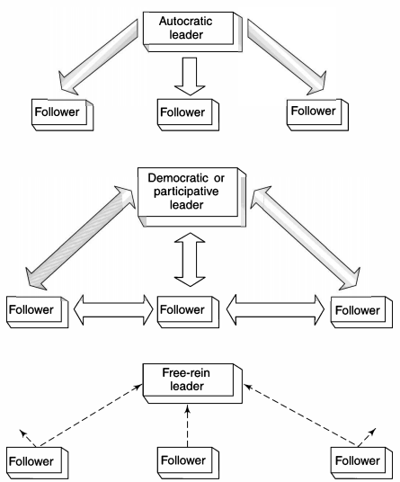
There are several theories on leadership behavior and styles
(1) leadership based on the use of authority,
(2) the managerial grid, and
(3) leadership involving a variety of styles, ranging from a maximum to a minimum use of power and influence
The Flow of Influence with Three Leadership Styles

Slide 38
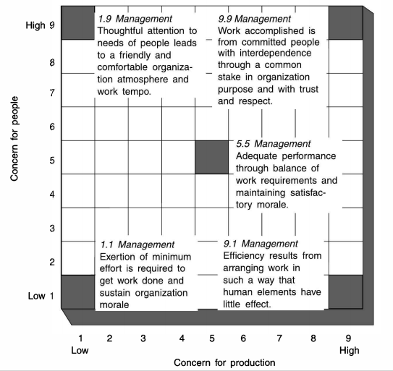
The managerial grid
Concern for production includes the attitude of a supervisor toward a wide variety of things, such as the quality of policy decisions, procedures and processes, creativeness of research, quality of service, work efficiency, and volume of output.
Concern for people includes such elements as the degree of personal commitment toward goal achievement, maintenance of the self-esteem of workers, placement of responsibility on the basis of trust rather than obedience, provision of good working conditions, and maintenance of satisfying interpersonal relations.

Slide 39
The managerial grid
1.1 Style (Impoverished Management)
managers concern themselves very little with either people or production and have minimum involvement in their jobs; to all intents and purposes, they have abandoned their jobs and only mark time or act as messengers communicating information from superiors to subordinates
9.9 Style (team based style or democratic management)
Managers display in their actions the highest possible dedication both to people and to production

Slide 40
The managerial grid
1.9 Style (called country club management by some)
Managers have little or no concern for production but are concerned only for people
They promote an environment in which everyone is relaxed, friendly, and happy and no one is concerned about putting forth coordinated effort to accomplish enterprise goals
9.1 Style (sometimes referred to as autocratic task managers)
Managers are concerned only with developing an efficient operation, who have little or no concern for people, and who are quite autocratic in their style of leadership
5.5 Style (Middle of the road or compromising leadership)

Slide 41
Leadership styles: autocratic
Top-down decision-making – Leaders make all key tech decisions (e.g., system architecture) with minimal input.
Effective in crisis – Useful during outages or security breaches requiring fast, firm direction.
Clear authority structure – Ideal for hierarchical teams (e.g., legacy software maintenance).
Low team morale risk – May stifle creativity and autonomy in agile environments.
Limited innovation – Reduces employee ownership and hinders innovation in long-term projects

Slide 42
Leadership styles: servant
Empowers developers and engineers – Leaders focus on supporting team growth and well-being.
Boosts collaboration – Common in DevOps or agile teams where trust and communication matter.
Fosters innovation – Encourages experimentation and employee-led initiatives.
Improves retention – Builds loyalty and lowers turnover among IT professionals.
Slow in emergencies – May delay decisions in time-sensitive tech operations

Slide 43
Leadership styles: transformational
Vision-driven change – Inspires teams to embrace cutting-edge tech (e.g., cloud migration, AI).
Motivates innovation – Encourages creativity in problem-solving and R&D.
Drives digital transformation – Leads major IT shifts in business models and architecture.
Mentors future leaders – Focuses on personal and professional development of team members.
Risk of burnout – High expectations and pace can overwhelm some team members

Slide 44
3.2.2 Characteristics of learning organization in the ICT industry
Continuous Learning Culture
Promotes ongoing upskilling in fast-evolving technologies (e.g., AI, cybersecurity, cloud).
Encourages certifications, bootcamps, and knowledge sharing sessions
Knowledge Management Systems
Uses platforms to capture, store, and share expertise (e.g., wikis, forums, internal knowledge bases).
Facilitates organizational memory across teams and locations.

Slide 45
3.2.2 Characteristics of learning organization in the ICT industry
Adaptability to Change
Rapidly adapts to new tech trends, market demands, and regulatory changes.
Embraces agile methodologies to enable organizational responsiveness.
Collaborative Environment
Fosters cross-functional teams and open communication (e.g., DevOps, agile squads).
Supports remote and hybrid collaboration tools like Slack, MS Teams, and Git

Slide 46
3.2.2 Characteristics of learning organization in the ICT industry
Innovation and Experimentation
Encourages risk-taking and prototyping (e.g., hackathons, R&D labs).
Accepts failure as part of the learning and innovation process.
Leadership That Supports Learning
Leaders act as coaches and facilitators, not just decision-makers.
Invests in learning platforms and employee development programs.

Slide 47
3.2.2 Characteristics of learning organization in the ICT industry
Employee Empowerment
Gives autonomy in decision-making and ownership of projects.
Builds a growth mindset among team members.
Employee Motivation

Slide 48
Company | Focus Area | Description / Contribution
Microsoft | Software, Cloud, AI
Google (Alphabet Inc.) | Search, Cloud, AI, Mobile OS
IBM | Enterprise IT, Cloud, AI
Apple Inc | Consumer Electronics, Software
Cisco Systems | Networking & Cybersecurity

Slide 49
Company | Focus Area | Description / Contribution
Infosys | IT Services & Consulting
Samsung Electronics | Consumer Electronics, Semiconductors
Amazon Web Services (AWS) | Cloud Computing
Huawei Technologies | Telecom Equipment, ICT Infrastructure
Tata Consultancy Services (TCS) | IT Services & Consulting

Slide 50
3.3 Challenges and strategies for motivating and leading technical workforce
Understanding and Managing Individual Behavior

Slide 51
Learning Objectives
Identify the focus and goals of individual behavior within organizations.
Explain the role that attitudes play in job performance.
Describe different personality theories.
Describe perception and the factors that influence it.
Discuss learning theories and their relevance in shaping behavior.

Slide 52
Focus and Goals of Organizational Behavior
Behavior: the actions of people
Organizational behavior: the study of the actions of people at work
Managers need good people skills.
The actions of people—organizational behavior is the study of the actions of people at work irrespective of their skills and roles
Notes:
Managers need good people skills. The material in this and the next three chapters draws heavily on the field of study that’s known as organizational behavior (OB). Although it’s concerned with the subject of behavior—that is, the actions of people—organizational behavior is the study of the actions of people at work.

Slide 53
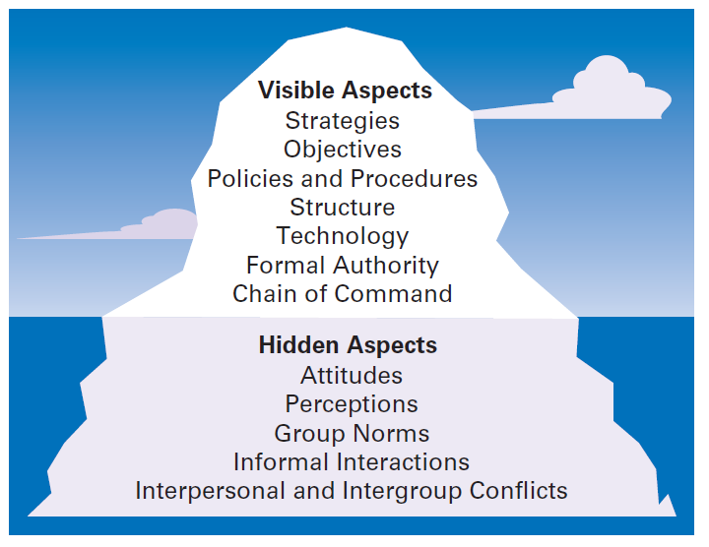
“Organization as an Iceberg” Metaphor
Figure shows that like an iceberg, O B has a small visible dimension and a much larger hidden portion.
Notes:
One of the challenges in understanding organizational behavior is that it addresses issues that aren’t obvious. Like an iceberg, OB has a small visible dimension and a much larger hidden portion. (See Exhibit 13-1.)
Long Description:
The illustration labels the part of the iceberg above the water as “Visible aspects” and the part of the iceberg below the water as “Hidden aspects.” The illustration also lists the aspects of each of them as follows.
Visible Aspects
Strategies
Objectives
Policies and Procedures
Structure
Technology
Formal Authority
Chain of Command
Hidden Aspects
Attitudes
Perceptions
Group Norms
Informal Interactions
Interpersonal and Intergroup Conflicts

Slide 54
Focus of Organizational Behavior
Individual behavior
attitudes, personality, perception, learning, and motivation
Group behavior
norms, roles, team building, leadership, and conflict
Organizational aspects
structure, culture, and human resource policies and practices
Notes:
Organizational behavior focuses on three major areas. First, OB looks at individual behavior. Based predominantly on contributions from psychologists, this area includes topics such as attitudes, personality, perception, learning, and motivation. Second, OB is concerned with group behavior, which includes norms, roles, team building, leadership, and conflict. Our knowledge about groups comes basically from the work of sociologists and social psychologists. Finally, OB also looks at organizational aspects including structure, culture, and human resource policies and practices. We’ve addressed group and organizational aspects in previous chapters. In this chapter, we’ll look at individual behavior.

Slide 55
Goals of Organizational Behavior
The goals of OB are to explain, predict, and influence behavior
Managers need to be able to explain why employees engage in some behaviors rather than others, predict how employees will respond to various actions and decisions, and influence how employees behave
Employee productivity: a performance measure of both efficiency and effectiveness
Absenteeism: the failure to show up for work
Turnover: the voluntary and involuntary permanent withdrawal from an organization
Notes:
The goals of OB are to explain, predict, and influence behavior. Managers need to be able to explain why employees engage in some behaviors rather than others, predict how employees will respond to various actions and decisions, and influence how employees behave.
What employee behaviors are we specifically concerned with explaining, predicting, and influencing? Six important ones have been identified: employee productivity, absenteeism, turnover, organizational citizenship behavior (OCB), job satisfaction, and workplace misbehavior. Employee productivity is a performance measure of both efficiency and effectiveness. Managers want to know what factors will influence the efficiency and effectiveness of employees. Absenteeism is the failure to show up for work. It’s difficult for work to get done if employees don’t show up. Turnover is the voluntary and involuntary permanent withdrawal from an organization. It can be a problem because of increased recruiting, selection, and training costs and work disruptions.

Slide 56
Goals of Organizational Behavior
Organizational citizenship behavior (O C B): discretionary behavior that is not part of an employee’s formal job requirements, but which promotes the effective functioning of the organization
Job satisfaction: an employee’s general attitude toward his or her job
Counterproductive workplace behavior: any intentional employee behavior that is potentially damaging to the organization or to individuals within the organization
Notes:
Organizational citizenship behavior (OCB) is discretionary behavior that’s not part of an employee’s formal job requirements but promotes the effective functioning of the organization.
Job satisfaction refers to an employee’s general attitude toward his or her job. Although job satisfaction is an attitude rather than a behavior, it’s an outcome that concerns many managers because satisfied employees are more likely to show up for work, have higher levels of performance, and stay with an organization.
Counterproductive workplace behavior is any intentional employee behavior that is potentially harmful to the organization or individuals within the organization. Workplace misbehavior shows up in organizations in four ways: deviance, aggression, antisocial behavior, and violence. Such behaviors can range from playing loud music just to irritate coworkers to verbal aggression to sabotaging work, all of which can create havoc in any organization.

Slide 57
Attitudes and Job Performance
Attitudes: evaluative statements, either favorable or unfavorable, concerning objects, people, or events
Examples of statements that reflect an attitude are:
“I like my job”
“I don’t care for my boss”
Notes:
Attitudes are evaluative statements—favorable or unfavorable—concerning objects, people, or events. They reflect how an individual feels about something. When a person says, “I like my job,” he or she is expressing an attitude about work. An attitude is made up of three components: cognition, affect, and behavior.

Slide 58
Attitude Components
Cognitive component: that part of an attitude that’s made up of the beliefs, opinions, knowledge, or information held by a person
Affective component: that part of an attitude that’s the emotional or feeling part
Behavioral component: that part of an attitude that refers to an intention to behave in a certain way toward someone or something
Notes:
The cognitive component of an attitude refers to the beliefs, opinions, knowledge, or information held by a person (for instance, the belief that “discrimination is wrong”). The affective component of an attitude is the emotional or feeling part of an attitude. Using our example, this component would be reflected by the statement, “I don’t like Pat because he discriminates against minorities.” Finally, affect can lead to behavioral outcomes. The behavioral component of an attitude refers to an intention to behave in a certain way toward someone or something.

Slide 59
Job Satisfaction
High level of satisfaction = positive attitude; Dissatisfaction = negative attitude
Linked to:
Productivity
Absenteeism
Turnover
Customer satisfaction
OCB
Counterproductive behavior
Notes:
A person with a high level of job satisfaction has a positive attitude toward his or her job. A person who is dissatisfied has a negative attitude. When people speak of employee attitudes, they usually are referring to job satisfaction.

Slide 60
Job Involvement and Organizational Commitment
Job involvement: the degree to which an employee identifies with his or her job, actively participates in it, and considers his or her job performance to be important to self-worth
Organizational commitment: the degree to which an employee identifies with a particular organization and its goals and wishes to maintain membership in that organization
Perceived organizational support: employees’ general belief that their organization values their contribution and cares about their well-being
Notes:
Job involvement is the degree to which an employee identifies with his or her job, actively participates in it, and considers his or her job performance to be important to his or her self-worth. Employees with a high level of job involvement strongly identify with and really care about the kind of work they do. Their positive attitude leads them to contribute in positive ways to their work.
Organizational commitment is the degree to which an employee identifies with a particular organization and its goals and wishes to maintain membership in that organization. Whereas job involvement is identifying with your job, organizational commitment is identifying with your employing organization.

Slide 61
Employee Engagement
Employee engagement: when employees are connected to, satisfied with, and enthusiastic about their jobs. Engagement is important because:
Highly engaged employees are passionate about and deeply connected to their work, and
disengaged employees have essentially “checked out” and don’t care. They show up for work, but have no energy or passion for it.
Notes:
Managers want their employees to be connected to, satisfied with, and enthusiastic about their jobs. This concept is known as employee engagement. Highly engaged employees are passionate about and deeply connected to their work. A number of benefits come from having highly engaged employees. First, highly engaged employees are two-and-a-half times more likely to be top performers than their less-engaged coworkers. In addition, companies with highly engaged employees have higher retention rates, which help keep recruiting and training costs low. And both of these outcomes—higher performance and lower costs—contribute to superior financial performance.

Slide 62
Attitudes and Consistency
People generally seek consistency among their attitudes and between their attitudes and behavior; they try to reconcile differing attitudes and align their attitudes and behavior, so they appear rational and consistent
Cognitive dissonance theory introduced on the next slide sought to explain the relationship between attitudes and behavior
Notes:
People seek to remove dissonance from their lives which impacts their behavior.

Slide 63
Cognitive Dissonance Theory
Cognitive dissonance: any incompatibility or inconsistency between attitudes or between behavior and attitudes
The theory proposes that how hard we’ll try to reduce dissonance is determined by three things:
(1) the importance of the factors creating the dissonance,
(2) the degree of influence the individual believes they have over those factors, and
(3) the rewards that may be involved in dissonance
Notes:
Cognitive dissonance theory sought to explain the relationship between attitudes and behavior. Cognitive dissonance is any incompatibility or inconsistency between attitudes or between behavior and attitudes. The theory argued that inconsistency is uncomfortable and that individuals will try to reduce the discomfort and thus, the dissonance.

Slide 64
Assessing Attitudes
Attitude surveys: surveys that elicit responses from employees through questions about how they feel about their jobs, work groups, supervisors, or the organization
Pulse survey: a short employee attitude survey sent to employees at a regular interval, such as weekly
Notes:
Many organizations regularly survey their employees about their attitudes. Typically, attitude surveys present the employee with a set of statements or questions eliciting how they feel about their jobs, work groups, supervisors, or the organization. Ideally, the items will be designed to obtain the specific information that managers desire. An attitude score is achieved by summing up responses to individual questionnaire items. These scores can then be averaged for work groups, departments, divisions, or the organization as a whole.

Slide 65
Sample Employee Attitude Survey
Here are some sample statements from an employee attitude survey:
I have ample opportunities to use my skills/abilities in my job.
My manager has a good relationship with my work group.
My organization provides me professional development opportunities.
I am told if I’m doing good work or not.
I feel safe in my work environment.
My organization is a great place to work.
Notes:
Exhibit 13-2 shows an example of an actual attitude survey.

Slide 66
Can Artificial Intelligence Help Improve Employee Attitudes?
AI can be used for the following tasks;
Tracking employee attitudes
Identifying opportunities to boost morale
Identifying opportunities to improve employee attitudes by changing work processes and automating tasks that workers may deem uninteresting
Making it easier for an employee to gather and organize information for a report
Notes:
As noted in the chapter opening, AI tools can support a more accurate assessment of employee attitudes and engagement at work. SML, a specialty chemical supplier based in Indonesia, used an AI tool to track employee attitudes, specifically employee happiness and stress levels, to identify opportunities to boost employee morale. The AI tool was programmed using past data from the organization including insights from in-depth employee interviews. Employees were then surveyed monthly, and management studied the patterns that emerged and planned responses depending on any concerns identified. For example, as they noticed an increase in stress levels, they were able to identify a miscommunication that was corrected.

Slide 67
Implications for Managers
Managers should be interested in their employees’ attitudes because they influence behavior and organizational performance.
For example, satisfied and committed employees:
have lower rates of turnover and absenteeism
perform better on the job
Notes:
If managers want to keep resignations and absences down—especially among their more productive employees—they’ll want to do things that generate positive job attitudes. Managers can focus on making work challenging and interesting, providing equitable rewards, creating supportive working conditions, and encouraging supportive colleagues.

Slide 68
Personality
Personality: the unique combination of emotional, thought, and behavioral patterns that affect how a person reacts to situations and interacts with others
Someone’s personality is commonly described with terms such as;
Quiet
Loud
Passive
Aggressive
Ambitious
Loyal
Notes:
An individual’s personality is a unique combination of emotional, thought, and behavioral patterns that affect how a person reacts to situations and interacts with others. It’s our natural way of doing things and relating to others. Personality is most often described in terms of measurable traits a person exhibits. We’re interested in looking at personality because just like attitudes, it too, affects how and why people behave the way they do.

Slide 69
Additional Personality Insights (1 of 2)
Locus of control: a personality attribute that measures the degree to which people believe they control their own fate
Self-esteem: an individual’s degree of like or dislike for himself or herself
Self-monitoring: a personality trait that measures the ability to adjust behavior to external situational factors
Notes:
Some people believe they control their own fate. Others see themselves as pawns, believing that what happens to them in their lives is due to luck or chance. The locus of control in the first case is internal; these people believe they control their own destiny. The locus of control in the second case is external; these people believe their lives are controlled by outside forces.
People differ in the degree to which they like or dislike themselves, a trait called self-esteem. Research on self-esteem (SE) offers some interesting behavioral insights. For example, self-esteem is directly related to expectations for success. High SEs believe they possess the ability they need to succeed at work. Individuals with high SEs will take more risks in job selection and are more likely to choose unconventional jobs than people with low SEs.
That natural ability to “click” with other people may play a significant role in determining career success and is another personality trait called self-monitoring, which refers to the ability to adjust behavior to external, situational factors. Individuals high in self-monitoring show considerable adaptability in adjusting their behavior. They’re highly sensitive to external cues and can behave differently in different situations.

Slide 70
Additional Personality Insights (2 of 2)
Risk-Taking: an individual’s willingness to take chances
Proactive personality: a personality trait that describes individuals who are more prone to take actions to influence their environments
Notes:
People differ in their willingness to take chances. Differences in the propensity to assume or to avoid risk have been shown to affect how long it takes managers to make a decision and how much information they require before making their choice. For instance, in one study where managers worked on simulated exercises that required them to make hiring decisions, high-risk-taking managers took less time to make decisions and used less information in making their choices than low risk-taking managers.
Another interesting trait that’s been studied extensively is the proactive personality, which describes people who identify opportunities, show initiative, take action, and persevere until meaningful change occurs. Not surprisingly, research has shown that proactives have many desirable behaviors that organizations want.

Slide 71
Personality Types in Different Cultures
No personality type is common for a given country, yet a country’s culture influences the dominant personality characteristics of its people
The five personality factors studied in the Big Five Model appear in almost all cross-cultural studies
Notes:
National cultures differ in terms of the degree to which people believe they control their environment. For instance, North Americans believe they can dominate their environment; other societies, such as those in Middle Eastern countries, believe life is essentially predetermined. Notice how closely this distinction parallels the concept of internal and external locus of control. On the basis of this particular cultural characteristic, we should expect a larger proportion of internals in the U.S. and Canadian workforces than in the workforces of Saudi Arabia or Iran.

Slide 72
Emotions and Emotional Intelligence
Emotions: intense feelings that are directed at someone or something
Emotional intelligence: the ability to notice and to manage emotional cues and information
Notes:
How we respond emotionally and how we deal with our emotions are typically functions of our personality. Emotions are intense feelings directed at someone or something. They’re object-specific; that is, emotions are reactions to an object.
One area of emotions research with interesting insights into personality is emotional intelligence (EI), the ability to notice and to manage emotional cues and information.

Slide 73
Five Dimensions of Emotional Intelligence
Self-awareness
Self-management
Self-motivation
Empathy
Social skills
Notes:
Emotional Intelligence is composed of five dimensions:
Self-awareness: The ability to be aware of what you’re feeling.
Self-management: The ability to manage one’s own emotions and impulses.
Self-motivation: The ability to persist in the face of setbacks and failures.
The last two dimensions of EI are:
Empathy: The ability to sense how others are feeling.
Social skills: The ability to handle the emotions of others.

Slide 74
Implications for Managers: Personality
Managers are likely to have higher-performing and more satisfied employees if consideration is given to matching personalities with jobs.
The single best trait associated with superior job performance is conscientiousness.

Slide 75
Four Suggestions Related to Hiring
Assess vocational interests in the hiring process
If you’re looking for a single personality trait that is likely to be associated with superior job performance, you’re well advised to hire people who score high on conscientiousness
When filling jobs where successful social interaction is a major factor in performance, hire people with high emotional intelligence
Take time to carefully screen job candidates to identify and reject individuals who hold the set of Dark Triad traits.
Notes:
We covered a lot of material on personality in this section. What should managers get out of this? Here are four suggestions related to hiring:
1. Assess vocational interests in the hiring process. By successfully matching interests and job requirements, there is an increased likelihood that new hires will perform well on the job and stay with the organization.
2. If you’re looking for a single personality trait that is likely to be associated with superior job performance, you’re well advised to hire people who score high on conscientiousness. Individuals who score high in conscientiousness are dependable, reliable, careful, thorough, organized, hard-working, and persistent. And these attributes tend to lead to higher job performance in most occupations.
3. When filling jobs where successful social interaction is a major factor in performance, hire people with high emotional intelligence. This should especially apply to managerial positions.
4. Finally, take time to carefully screen job candidates—through intensive interviews, reference checks, and the like—to identify and reject individuals who hold the set of Dark Triad traits. Although individuals with these traits typically come with some positive qualities, the toxic side of their personalities is likely to pollute their work environments. And when hiring mistakes are made, correct them quickly—preferably during their probationary period.

Slide 76
Perception
Perception: process by which we give meaning to our environment by organizing and interpreting sensory impressions
Research on perception consistently demonstrates that individuals may look at the same thing yet perceive it differently.
Notes:
Have the students attempt to read the opening paragraph in this section and then survey the class. How many could read it?

Slide 77
Factors that Influence Perception
A number of factors act to shape and sometimes distort perception including:
Perceiver
Target characteristics
Context
Notes:
Perception is a process by which we give meaning to our environment by organizing and interpreting sensory impressions.
Research on perception consistently demonstrates that individuals may look at the same thing yet perceive it differently. One manager, for instance, can interpret the fact that her assistant regularly takes several days to make important decisions as evidence that the assistant is slow, disorganized, and afraid to make decisions. Another manager with the same assistant might interpret the same tendency as evidence that the assistant is thoughtful, thorough, and deliberate. The first manager would probably evaluate her assistant negatively; the second manager would probably evaluate the person positively. The point is that none of us sees reality. We interpret what we see and call it reality. And, of course, as the example shows, we behave according to our perceptions.

Slide 78
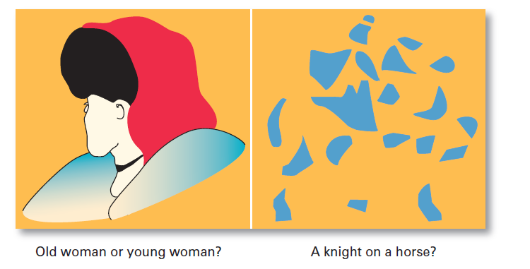
What Do You See?
Notice how what you see changes as you look differently at each one.
Notes:
The characteristics of the target being observed can also affect what’s perceived. Loud people are more likely than quiet people to be noticed in a group as are extremely attractive or unattractive individuals. The relationship of a target to its background also influences perception, as does our tendency to group close things and similar things together. You can experience these tendencies by looking at the visual perception examples shown in Exhibit 13-5. Notice how what you see changes as you look differently at each one.

Slide 79
Attribution Theory (1 of 2)
Attribution theory: a theory used to explain how we judge people differently depending on what meaning we attribute to a given behavior
Attribution depends on three factors:
Distinctiveness
Consensus
Consistency
Notes:
Attribution theory was developed to explain how we judge people differently depending on what meaning we attribute to a given behavior. Basically, the theory suggests that when we observe an individual’s behavior, we attempt to determine whether it was internally or externally caused. Internally caused behaviors are those believed to be under the personal control of the individual. Externally caused behavior results from outside factors; that is, the person is forced into the behavior by the situation. That determination, however, depends on three factors: distinctiveness, consensus, and consistency.

Slide 80
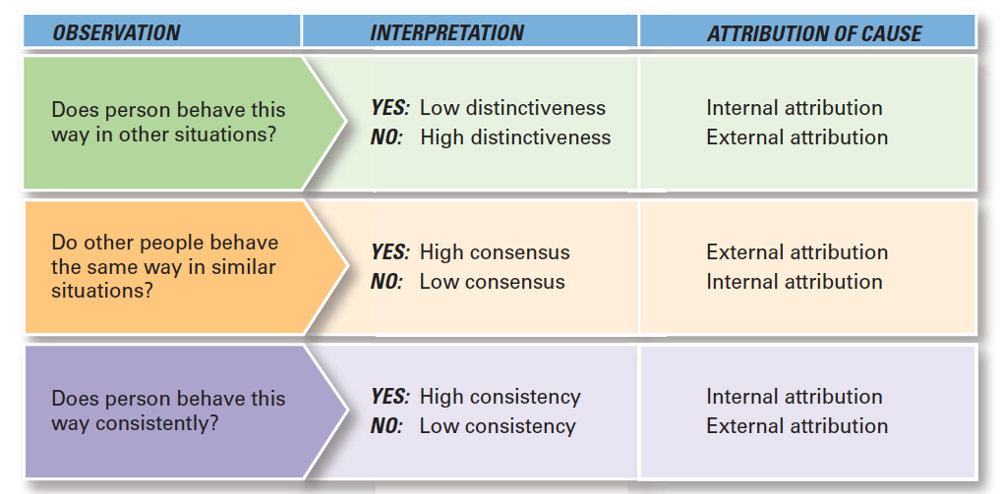
Attribution Theory
Exhibit 13-6 summarizes the key elements of attribution theory
Notes:
Long Description:
The chart shows the following: 1. Observation: Does person behave this way in other situations? Interpretation: Yes (Low distinctiveness); Attribution of cause: Internal attribution; Interpretation: No (High distinctiveness); Attribution of cause: External attribution. 2. Observation: Do other people behave the same way in similar situations? Interpretation: Yes (High consensus); Attribution of cause: External attribution; Interpretation: No (Low consensus); Attribution of cause: Internal attribution. 3. Observation: Does person behave this way consistently? Interpretation: Yes (High consistency); Attribution of cause: Internal attribution; Interpretation: No (Low consistency); Attribution of cause: External attribution.

Slide 81
Attribution Theory (2 of 2)
Fundamental attribution error: the tendency to underestimate the influence of external factors and to overestimate the influence of internal or personal factors
Self-serving bias: the tendency of individuals to attribute their successes to internal factors while blaming personal failures on external factors
Notes:
One interesting finding from attribution theory is that errors or biases distort our attributions. For instance, substantial evidence supports the fact that when we make judgments about the behavior of other people, we have a tendency to underestimate the influence of external factors and to overestimate the influence of internal or personal factors. This tendency is called the fundamental attribution error and can explain why a sales manager may attribute the poor performance of her sales representative to laziness rather than to the innovative product line introduced by a competitor.
This tendency is called the self-serving bias and suggests that feedback provided to employees in performance reviews will be distorted by them depending on whether it’s positive or negative.

Slide 82
Shortcuts Used in Judging Others
Selective perception: we make selections based on our own background, experience, interests and other factors unique to us
Assumed similarity: the assumption that others are like oneself
Stereotyping: judging a person based on a perception of a group to which that person belongs
Notes:
Any characteristic that makes a person, an object, or an event stand out will increase the probability we will perceive it. Why? Because it is impossible for us to assimilate everything we see; we can take in only certain stimuli. Thus, you are more likely to notice cars like your own, and your boss may reprimand some people and not others doing the same thing. Because we can’t observe everything going on around us, we use selective perception.
It’s easy to judge others if we assume they’re similar to us. In assumed similarity, or the “like me” effect, the observer’s perception of others is influenced more by the observer’s own characteristics than by those of the person observed.
When we judge someone on the basis of our perception of a group he or she is part of, we’re using the shortcut called stereotyping. For instance, “Married people are more stable employees than single persons” is an example of stereotyping.

Slide 83
Additional Shortcuts Used in Judging Others
Halo effect: a general impression of an individual based on a single characteristic
Contrast effect: our perception of someone or something can be influenced by the context or surroundings
Notes:
When we form a general impression about a person on the basis of a single characteristic, such as intelligence, sociability, or appearance, we’re influenced by the halo effect.
There’s an adage among show-business entertainers to “never follow an act with kids or animals.” Why? Audiences love children and animals, so you’ll look bad in comparison. This example illustrates how the contrast effect can distort perceptions. We don’t evaluate a person in isolation. Our reaction is influenced by other people we have recently encountered.

Slide 84
Implications for Managers: Perception
Managers need to recognize that their employees react to perceptions, not to reality
Employees organize and interpret what they see, so the potential for perceptual distortion is always present
Managers should pay close attention to how employees perceive both their jobs and management actions
Notes:
So whether a manager’s appraisal of an employee’s performance is actually objective and unbiased or whether the organization’s wage levels are among the highest in the community is less relevant than what employees perceive them to be. If individuals perceive appraisals to be biased or wage levels as low, they’ll behave as if those conditions actually exist.

Slide 85
Learning
Learning is defined as any relatively permanent change in behavior that occurs as a result of experience
Two learning theories help us understand individual behavior:
1. Social Learning Theory
2. Operant Conditioning
Notes:
Learning is included in our discussion of individual behavior for the obvious reason that almost all behavior is learned. If we want to explain, predict, and influence behavior, we need to understand how people learn.

Slide 86
Social Learning
Social learning theory: a theory of learning that says people can learn through observation and direct experience
The influence on behavior is determined by four factors:
Attentional processes
Retention processes
Motor reproduction processes
Reinforcement processes
Notes:
Much of what we have learned comes from watching others (models)—parents, teachers, peers, television and movie actors, managers, and so forth. This view that we can learn both through observation and direct experience is called social learning theory. The influence of others is central to the social learning viewpoint. The amount of influence these models have on an individual is determined by four processes:
Attentional processes. People learn from a model when they recognize and pay attention to its critical features. We’re most influenced by models who are attractive, repeatedly available, thought to be important, or seen as similar to us.
Retention processes. A model’s influence will depend on how well the individual remembers the model’s action, even after the model is no longer readily available.
Motor reproduction processes. After a person has seen a new behavior by observing the model, the watching must become doing. This process then demonstrates that the individual can actually do the modeled activities.
Reinforcement processes. Individuals will be motivated to exhibit the modeled behavior if positive incentives or rewards are provided. Behaviors that are reinforced will be given more attention, learned better, and performed more often.

Slide 87
Shaping: A Managerial Tool (1 of 2)
Shaping behavior: shaping is a behavior modification approach based on operant conditioning that managers can use to “mold” individuals by guiding their learning in graduated steps
Operant conditioning: a theory of learning that says behavior is a function of its consequences
Notes:
Because learning takes place on the job as well as prior to it, managers are concerned with how they can teach employees to behave in ways that most benefit the organization. Thus, managers will often attempt to “mold” individuals by guiding their learning in graduated steps, through a method called shaping behavior.
Operant conditioning argues that behavior is a function of its consequences. People learn to behave to get something they want or to avoid something they don’t want. Operant behavior is voluntary or learned behavior, not reflexive or unlearned behavior. The tendency to repeat learned behavior is influenced by reinforcement or lack of reinforcement that happens as a result of the behavior. Reinforcement strengthens a behavior and increases the likelihood that it will be repeated. Lack of reinforcement weakens a behavior and lessens the likelihood that it will be repeated.

Slide 88
Shaping: A Managerial Tool (2 of 2)
There are four ways to shape behavior;
Positive reinforcement
Negative reinforcement
Punishment
Extinction
Notes:
Because learning takes place on the job as well as prior to it, managers are concerned with how they can teach employees to behave in ways that most benefit the organization. Thus, managers will often attempt to “mold” individuals by guiding their learning in graduated steps, through a method called shaping behavior.
Four ways to shape behavior include positive reinforcement, negative reinforcement, punishment, and extinction. When a behavior is followed by something pleasant, such as praising an employee for a job well done, it’s called positive reinforcement. Positive reinforcement increases the likelihood that the desired behavior will be repeated. Rewarding a response by eliminating or withdrawing something unpleasant is negative reinforcement. A manager who says, “I won’t dock your pay if you start getting to work on time” is using negative reinforcement. The desired behavior (getting to work on time) is being encouraged by the withdrawal of something unpleasant (the employee’s pay being docked). On the other hand, punishment penalizes undesirable behavior and will eliminate it. Suspending an employee for two days without pay for habitually coming to work late is an example of punishment. Finally, eliminating any reinforcement that’s maintaining a behavior is called extinction. When a behavior isn’t reinforced, it gradually disappears.

Slide 89
Implications for Managers: Learning
Employees are going to learn on the job: are managers going to manage their learning through the rewards they allocate and the examples they set, or allow it to occur haphazardly?
If marginal employees are rewarded with pay raises and promotions, they will have little reason to change their behavior
Productive employees who see marginal performance rewarded might change their behavior
Notes:
If managers want behavior A, but reward behavior B, they shouldn’t be surprised to find employees learning to engage in behavior B. Similarly, managers should expect that employees will look to them as models.

